Slide 1
Operating Systems
Process
FBA

Slide 2
Process Concept
What to call the activities of CPU ?
User Programs
or
Tasks
Jobs
Batch System
Time Sharing System
These activities are called “Processes”
The terms “job” and “process” are used almost interchangeably.
Notes:
A question that arises in discussing operating systems involves what to call all the CPU activities.
A batch system executes jobs, whereas a time-shared system has user programs, or tasks.
A single-user system, a user may be able to run several programs at one time: a word processor, aWeb browser, and an e-mail package.
Even if a device or system does not support multitasking, the operating system may need to support its own internal programmed activities.
In many respects, all these activities are similar, so we call all of them processes.
Although we personally prefer the term process, much of operating-system theory and terminology was developed during a time when the major activity
of operating systems was job processing.

Slide 3
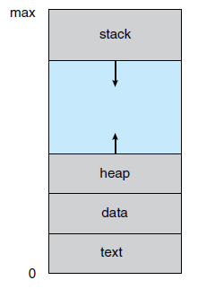
Process
A process is a program that is in execution.
But, it is more than the program codes. Program code is known as “text section” of a process.
Besides code of the program, it contains -
Program Counter and Registers: stores current activity of the process
Stack: Temporary data (function parameter, local variables, return addresses etc.)
Data Section: Global Variables
Heap: dynamically allocated memory during runtime

Slide 4
Program Vs Process
Program is passive entity stored on disk (executable file); process is active
Program becomes process when an executable file is loaded into memory
Execution of program started via GUI mouse clicks, command line entry of its name, etc.
One program can be several processes
Consider multiple users executing the same program
next address to execute
Program counter
Program
Loaded into
memory
a=10
b=5
print(a+b)
…
...
Value of a is 10
Data section
program1.exe
print(a+b)
b=5
Text section
a=10
Corresponding process in memory

Slide 5
Same program, Different Process
Process 1
Browser ( first window)
Code 1
Program code is same
Data, Heap, Stacks contains different information
Process 2
Browser ( second window)
Browser program
Process 3
Browser ( third window)

Slide 6
States of a Process
A process state defines the current activity of that process.
The states a process can be:
New: Process is being created
Running: Instructions are being executed
Waiting: Process is waiting for some event to occur
Ready: Waiting to be assigned to a processor
Terminated: Process has finished execution

Slide 7
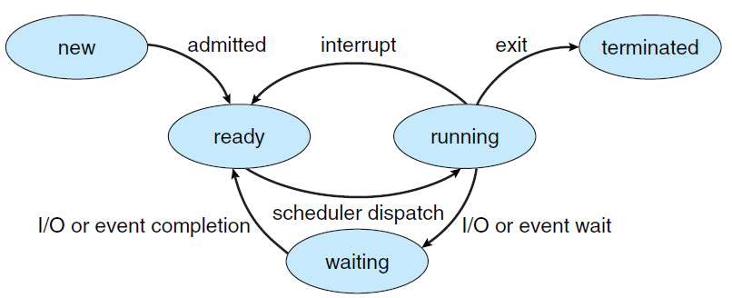
Process State Diagram

Slide 8
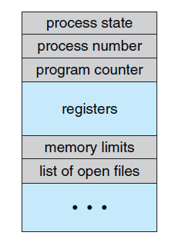
Representation of Processes in OS
Each process is represented in the operating system by a Process Control Block (PCB) or Task Control Block
PCB is a data structure to store information of Processes such as -
Process state – running, waiting, etc.
Program counter – location of instruction to next execute
CPU registers – contents of all process-centric registers
CPU scheduling information- priorities, scheduling queue pointers
Memory-management information – memory allocated to the process
Accounting information – CPU used, clock time elapsed since start, time limits
I/O status information – I/O devices allocated to process, list of open files

Slide 9
Threads
So far, process has a single thread of execution
Consider having multiple program counters per process
Multiple locations can execute at once
Multiple threads of control -> threads
Must then have storage for thread details, multiple program counters in PCB
Explore the details later

Slide 10
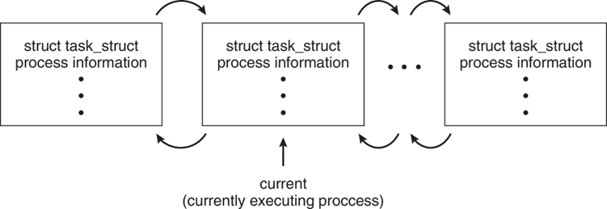
Process Representation in Linux
Represented by the C structure task_struct
pid t_pid; /* process identifier */
long state; /* state of the process */
unsigned int time_slice /* scheduling information */
struct task_struct *parent; /* this process’s parent */
struct list_head children; /* this process’s children */
struct files_struct *files; /* list of open files */
struct mm_struct *mm; /* address space of this process */

Slide 11
Operating Systems
Process Scheduling
FBA

Slide 12
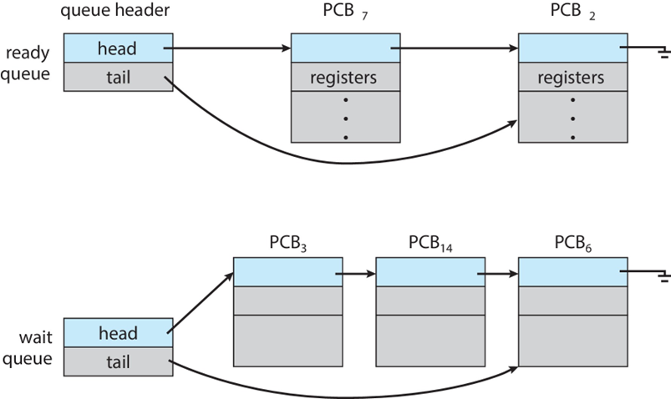
Process Scheduling
Process scheduler selects among available processes for next execution on CPU core
Goal -- Maximize CPU use, quickly switch processes onto CPU core
Maintains scheduling queues of processes
Ready queue – set of all processes residing in main memory, ready and waiting to execute
Wait queues – set of processes waiting for an event (i.e., I/O)
Processes migrate among the various queues

Slide 13
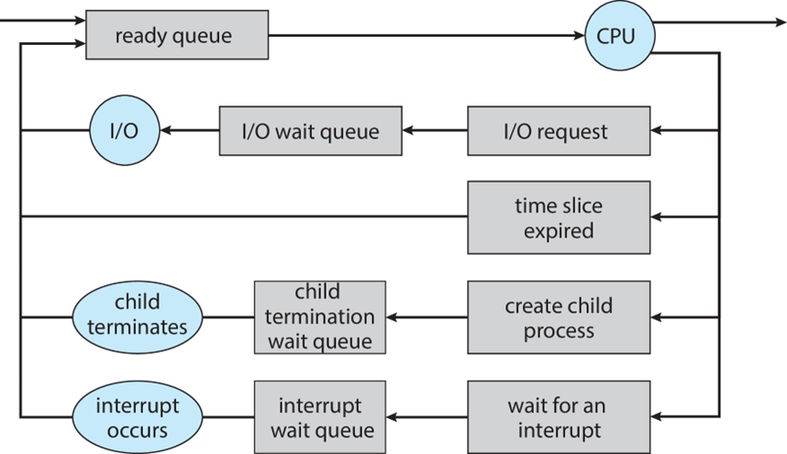
Representation of Process Scheduling

Slide 14
Schedulers
Schedulers select processes from different queues to be passed to the next phase.
CPU
Long Term Scheduler
Short Term Scheduler
Job Queue
Ready Queue
Less frequently executed.
Controls degree of multiprogramming.
More frequently executed.

Slide 15
CPU Bound Vs I/O Bound Process
CPU bound processes spend more time doing computation using processors than I/O.
I/O bound processes spend more time in I/O than CPU.
Long Term Scheduler must select wisely !
What will happen if all processes are I/O bound ?
=> Empty ready queue
What will happen if all processes are CPU bound ?
=> Empty waiting queue
CPU
Ready Queue
End
I/O
I/O Queue

Slide 16
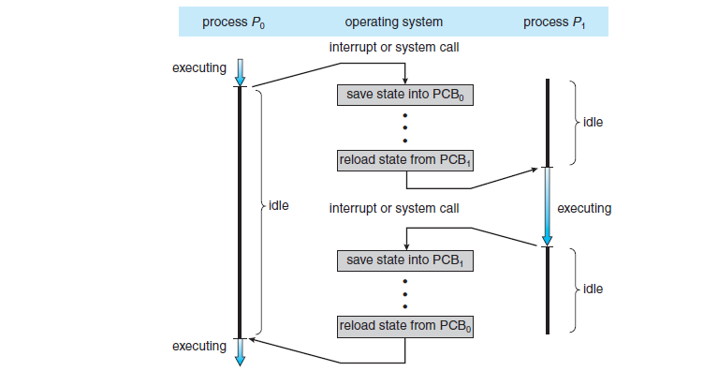
Context Switch
A context switch occurs when the CPU switches from one process to another.
Context Switch:
1. Storing currently executed process context
2. Restoring the next process context to execute
Overhead for context switch from P0 to P1
Overhead for context switch from P1 to P0

Slide 17
Context Switch
When CPU switches to another process, the system must save the state of the old process and load the saved state for the new process via a context switch
Context of a process represented in the PCB
Context-switch time is pure overhead; the system does no useful work while switching
The more complex the OS and the PCB => the longer the context switch
Time dependent on hardware support
Some hardware provides multiple sets of registers per CPU => multiple contexts loaded at once

Slide 18
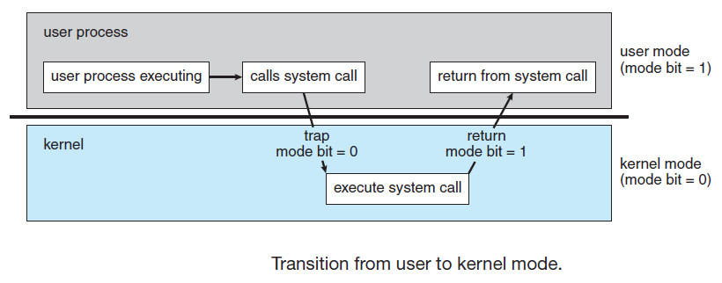
Dual Mode Operation
Need to distinguish between the execution of operating-system code and user defined code.
A bit, called the mode bit, is added to the hardware of the computer to indicate the current mode: kernel (0) or user (1).
dual mode of operation provides protection of the operating system from errant users
this protection is provided by designating some of the machine instructions that may cause harm as privileged instructions that are executed only in kernel mode.

Slide 19
System Calls
Programming interface to the services provided by the OS
Typically written in a high-level language (C or C++)
Mostly accessed by programs via a high-level Application Programming Interface (API) rather than direct system call use
Three most common APIs are Win32 API for Windows, POSIX API for POSIX-based systems (including virtually all versions of UNIX, Linux, and Mac OS X), and Java API for the Java virtual machine (JVM)
Note: the system-call names used throughout this text are generic

Slide 20
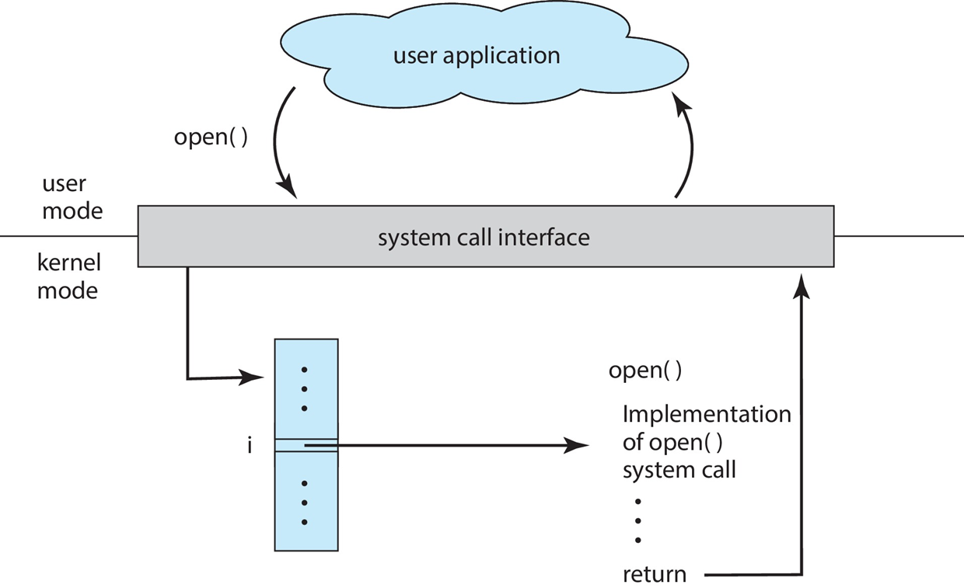
System Call Implementation
Typically, a number is associated with each system call
System-call interface maintains a table indexed according to these numbers
The system call interface invokes the intended system call in OS kernel and returns status of the system call and any return values
The caller need know nothing about how the system call is implemented
Just needs to obey API and understand what OS will do as a result call
Most details of OS interface hidden from programmer by API
Managed by run-time support library (set of functions built into libraries included with compiler)
Figure: API – System Call – OS Relationship

Slide 21
Types of System Call
Type | Windows OS | Linux OS
Process Control | CreateProcess() ExitProcess() WaitForSingleObject() | fork() exit() wait()
File Manipulation | CreateFile() ReadFile() WriteFile() CloseHandle() | open() read() write() close()
Device Manipulation | SetConsoleMode() ReadConsole() WriteConsole() | ioctl() read() write()

Slide 22
Types of System Call
Type | Windows OS | Linux OS
Information Maintenance | GetCurrentProcessID() SetTimer() Sleep() | getpid() alarm() sleep()
Communication | CreatePipe() CreateFileMapping() MapViewOfFile() | pipe() shm_open() mmap()
Protection | SetFileSecurity() InitlializeSecurityDescriptor() SetSecurityDescriptorGroup() | chmod() umask() chown()

Slide 23
Operating Systems
Operations on Process
FBA

Slide 24
Operations on Processes
System must provide mechanisms for:
Process creation
Process termination

Slide 25
Process Creation
Parent process create children processes, which, in turn create other processes, forming a tree of processes
Generally, process identified and managed via a process identifier (pid)
Resource sharing options
Parent and children share all resources
Children share subset of parent’s resources
Parent and child share no resources
Execution options
Parent and children execute concurrently
Parent waits until children terminate
P1
pid = 1
P2
pid = 8
P3
pid = 58
P4
pid = 63
Parent process
P5
pid = 51
P6
pid = 38
P7
pid = 55
Child process

Slide 26
Process Creation
When a process creates new process -
The parent continues to execute concurrently with its children
Or,
The parent waits until some or all of its children have terminated
Two address-space possibilities for the new process -
The child process is a duplicate of the parent process
Or
The child process has a new program loaded into it.

Slide 27
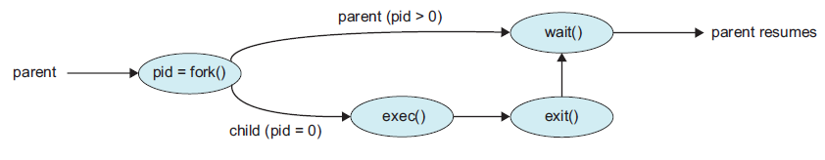
Process creation in UNIX
System Call: offers the services of the operating system to the user programs.
fork(): create a new process, which becomes the child process of the caller
exec(): runs an executable file , replacing the previous executable
wait(): suspends execution of the current process until one of its children terminates.
Fig: Process creation using fork() system call

Slide 28
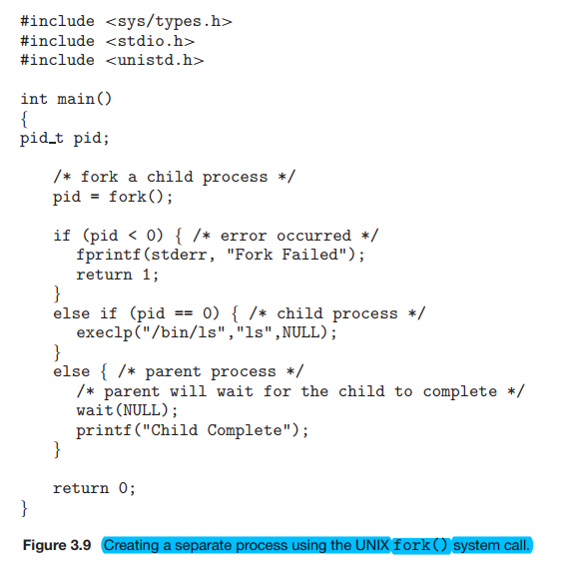

Slide 29
int main(){
fork();
fork();
printf(“A”);
}
int main(){
fork();
fork();
fork();
printf(“A”);
}

Slide 30
int main(){
a = fork();
if(a==0) fork();
fork();
printf(“A”);
}
int main(){
fork();
a = fork();
if(a==0) fork();
printf(“A”);
}

Slide 31
int main(){
int x = 1;
a = fork();
if(a==0){
x = x -1;
printf(“value of x is: %d”, x);
}
else if (a>0){
wait(NULL);
x = x +1;
printf(“value of x is: %d”, x);
}
}
Hint: The parent prints after the child because of wait(NULL).

Slide 32
Process Termination
Process executes last statement and then asks the operating system to delete it using the exit() system call
Returns status data from child to parent (via wait())
Process’ resources are deallocated by operating system
Parent may terminate the execution of children processes using the abort() system call. Some reasons for doing so:
Child has exceeded allocated resources
Task assigned to child is no longer required
The parent is exiting, and the operating systems does not allow a child to continue if its parent terminates
Some operating systems do not allow child to exists if its parent has terminated. If a process terminates, then all its children must also be terminated.
Cascading termination: All children, grandchildren, etc., are terminated.
The termination is initiated by the operating system.
The parent process may wait for termination of a child process by using the wait() system call. The call returns status information and the id of the terminated process
pid = wait(&status);
If no parent waiting (did not invoke wait()) process is a zombie
If parent terminated without invoking wait(), process is an orphan

Slide 33
Operating Systems
Interprocess Communication
FBA

Slide 34
Processes in the system
Processes running concurrently may be -
Independent (cannot affect or be affected by other process)
Or
Cooperating (can affect or be affected by other process)
Process cooperation is needed for -
Information sharing
Computational speedup
Modularity
Convenience

Slide 35
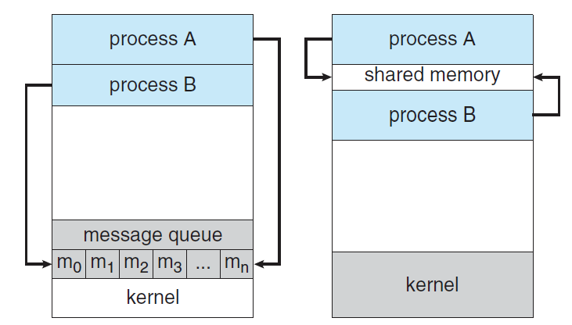
Inter Process Communication
IPC is a mechanism to exchange data and information among processes.
Two fundamental model of IPC -
Shared Memory
Message Passing

Slide 36
Shared Memory System
(Producer-Consumer Problem)
Producer: produces products for consumer
Consumer: consumes products provided by producer
Produce
Share Space /
Buffer
Consume
Producer
Consumer

Slide 37
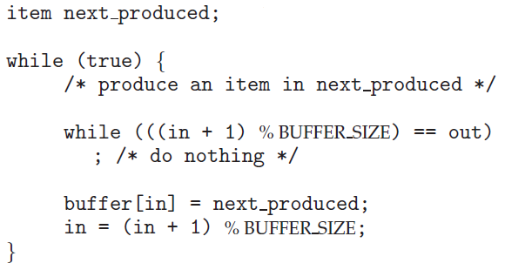
Producer-Consumer Problem (Producer)
in: next free position in buffer
out: first full position in buffer
Both initialized with 0.
in = 0
out = 0
Here, BUFFER_SIZE = 7
When buffer is full,
in = 6 , out = 0
When buffer is not full,
In = 4, out = 0
[0] [1] [2] [3] [4] [5] [6]
[0] [1] [2] [3] [4] [5] [6]

Slide 38
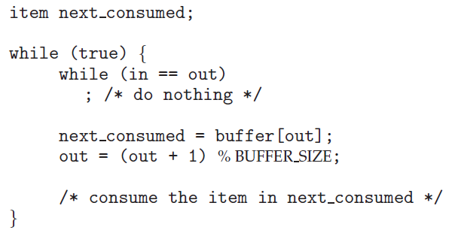
Producer-Consumer Problem (Consumer)
in: next free position in buffer
out: first full position in buffer
Both initialized with 0.
in = 0
out = 0
Here, BUFFER_SIZE = 7
When buffer is empty,
in = 0 , out = 0
When buffer is not empty,
In = 5, out = 0
[0] [1] [2] [3] [4] [5] [6]
[0] [1] [2] [3] [4] [5] [6]

Slide 39
Message Passing System
If processes P and Q want to communicate, they must send messages to and receive messages from each other.
A communication link must exist between P and Q.
send(message)
P
Q
M1
M2
M3
M4
receive(message)
Useful for exchanging small amount of data
More suited for distributed systems than shared memory

